Slide 1

Deep Learning for Natural Language Processing:
Recurrent Neural Network
June 2019

Slide 2
Overview
Introduce a new NLP task
Language Modeling
Introduce a new family of neural networks
Recurrent Neural Networks (RNNs)
Christopher Manning & Abigail See

Slide 3
Language Modeling

Slide 4
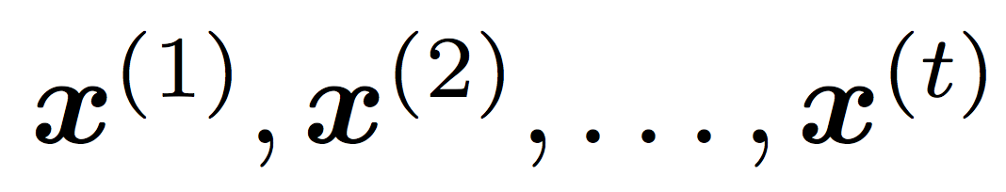
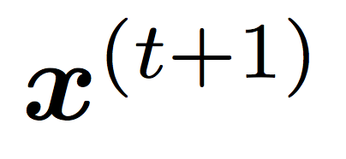
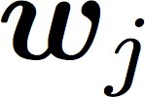
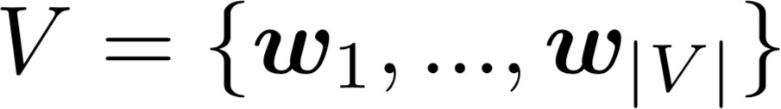
Language Modeling
Language Modeling is the task of predicting what word comes
next.
books
laptops
the students opened their
exams
minds
More formally: given a sequence of words
compute the probability distribution of the next word
,
:
where is a word in the vocabulary
A system that does this is called a Language Model.
Christopher Manning & Abigail See

Slide 5
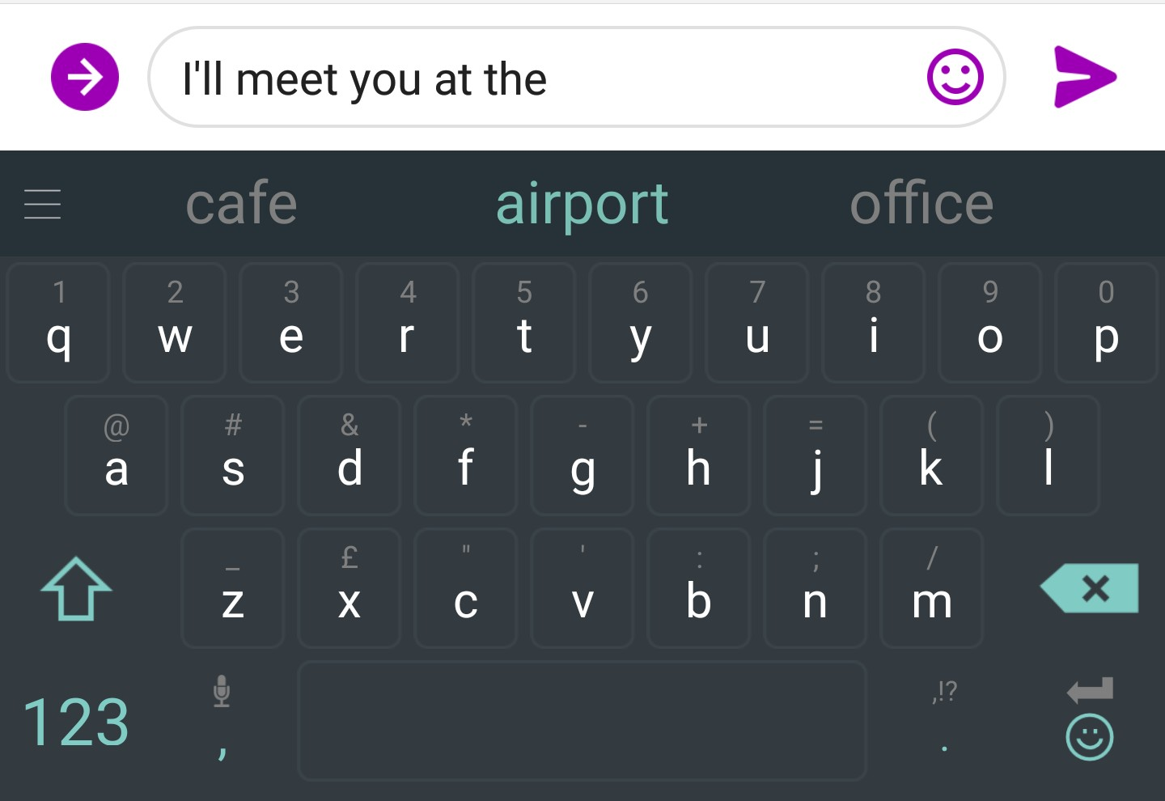
You use Language Models every day!
Christopher Manning & Abigail See

Slide 6
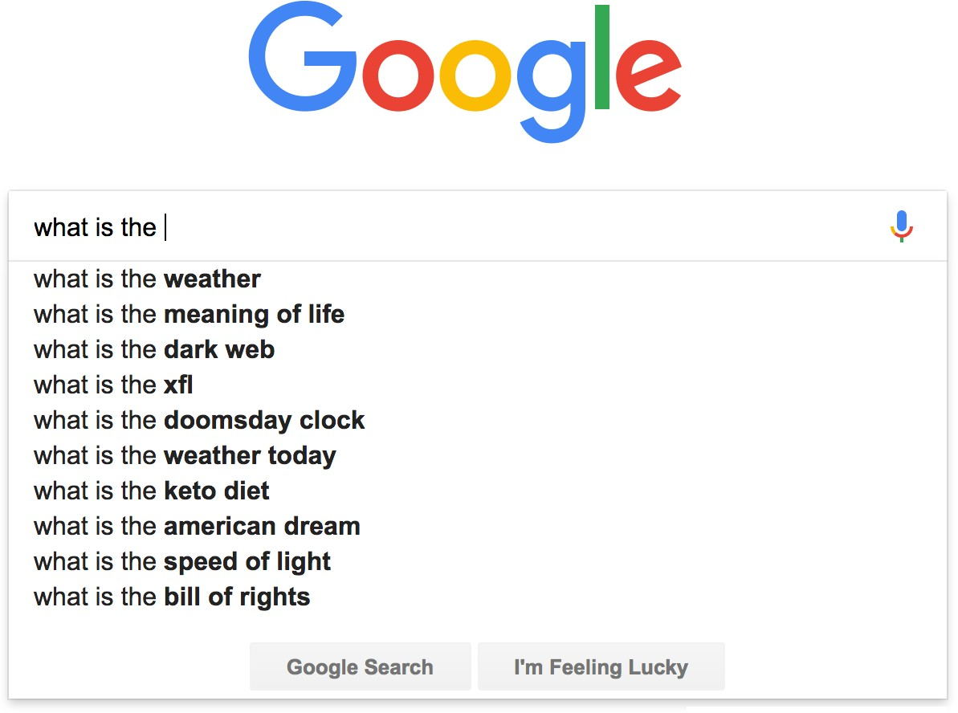
You use Language Models every day!
Christopher Manning & Abigail See

Slide 7
n-gram Language Models
the students opened their
Question: How to learn a Language Model?
Answer (pre- Deep Learning): learn a n-gram Language Model!
Definition: A n-gram is a chunk of n consecutive words.
unigrams: “the”, “students”, “opened”, ”their”
bigrams: “the students”, “students opened”, “opened their”
trigrams: “the students opened”, “students opened their”
4-grams: “the students opened their”
Idea: Collect statistics about how frequent different n-grams are, and use these to predict next word.
Christopher Manning & Abigail See

Slide 8
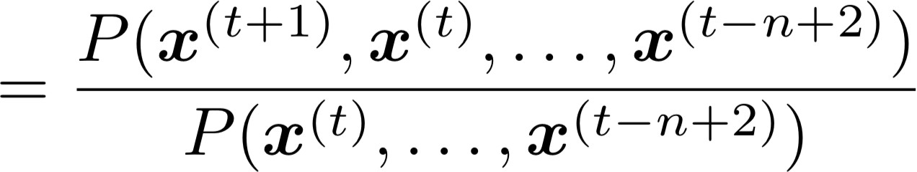
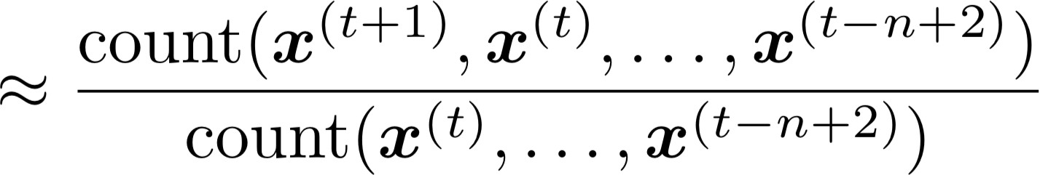
n-gram Language Models
First we make a simplifying assumption: preceding (n-1) words
n-1 words
depends only on the
(assumption)
prob of a n-gram
(definition of conditional prob)
prob of a (n-1)-gram
Question: How do we get these n-gram and (n-1)-gram probabilities?
Answer: By counting them in some large corpus of text!
(statistical approximation)
Christopher Manning & Abigail See

Slide 9
n-gram Language Models
Suppose we are learning a 4-gram Language Model.
as the proctor started the clock, the
students opened their
condition on this
discard
In the corpus:
“students opened their” occurred 1000 times
“students opened their books” occurred 400 times
→ P(books | students opened their) = 0.4
“students opened their exams” occurred 100 times
→ P(exams | students opened their) = 0.1
Should we have discarded the “proctor” context?
Christopher Manning & Abigail See

Slide 10
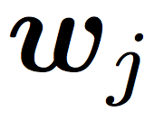
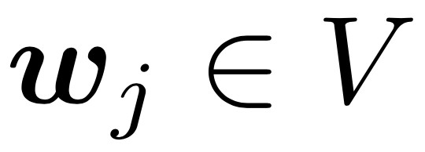
Problems with n-gram Language Models
Sparsity Problem 1
Problem: What if “students opened their ” never occurred in data? Then
has probability 0!
(Partial) Solution: Add small 𝛿
to count for every . This is called smoothing.
Sparsity Problem 2
Problem: What if “students opened their” never occurred in data? Then we can’t calculate probability for any !
(Partial) Solution: Just condition on “opened their” instead.
This is called backoff.
Note: Increasing n makes sparsity problems worse.
Typically we can’t have n bigger than 5.
Christopher Manning & Abigail See

Slide 11
Problems with n-gram Language Models
Storage: Need to store count for all possible n-grams. So model size is O(exp(n)).
Increasing n makes model size huge!
Christopher Manning & Abigail See

Slide 12
n-gram Language Models in practice
You can build a simple trigram Language Model over a
1.7 million word corpus (Reuters) in a few seconds on your laptop*
Business and financial news
today the
get probability distribution
company |  | 0.153
bank |  | 0.153
price |  | 0.077
italian |  | 0.039
emirate | … | 0.039
Sparsity problem: not much granularity in the probability distribution
* Try for yourself: https://nlpforhackers.io/language-models/
Otherwise, seems reasonable!
Christopher Manning & Abigail See

Slide 13
Generating text with a n-gram Language Model
You can also use a Language Model to generate text.
today the
condition on this
get probability distribution
company bank price italian emirate
0.153
0.153
0.077 sample
0.039
0.039
…
Christopher Manning & Abigail See

Slide 14
Generating text with a n-gram Language Model
You can also use a Language Model to generate text.
today the price
condition on this
get probability distribution
of for it to is
0.308
0.050
0.046
0.046
0.031
sample
…
Christopher Manning & Abigail See

Slide 15
Generating text with a n-gram Language Model
You can also use a Language Model to generate text.
today the price of
condition on this
get probability distribution
the 18
oil its gold
0.072
0.043
0.043
0.036
0.018
sample
…
Christopher Manning & Abigail See

Slide 16
Generating text with a n-gram Language Model
You can also use a Language Model to generate text.
today the price of gold
Christopher Manning & Abigail See

Slide 17
Generating text with a n-gram Language Model
You can also use a Language Model to generate text.
today the price of gold per ton , while production of shoe lasts and shoe industry , the bank intervened just after it considered and rejected an imf demand to rebuild depleted european stocks , sept 30 end primary 76 cts a share .
Incoherent! We need to consider more than 3 words at a time if we want to generate good text.
But increasing n worsens sparsity problem, and exponentially increases model size…
Christopher Manning & Abigail See

Slide 18
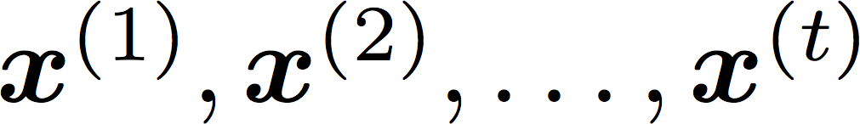
How to build a neural Language Model?
Recall the Language Modeling task:
Input: sequence of words
Output: prob dist of the next word
How about a window-based neural model?
We saw this applied to Named Entity Recognition in Lecture 4
Christopher Manning & Abigail See

Slide 19
A fixed-window neural Language Model
as the proctor started the clock
the students opened
fixed window
their
discard
Christopher Manning & Abigail See

Slide 20


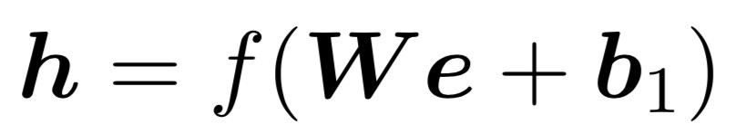







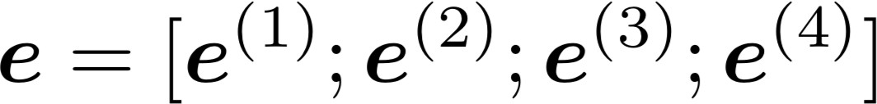






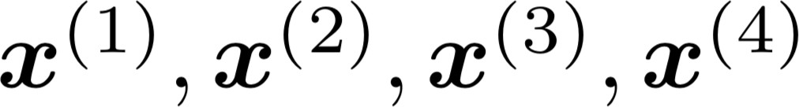
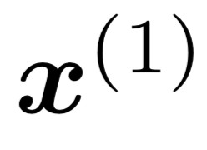
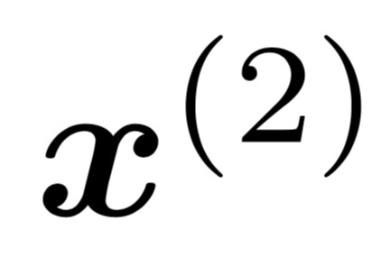
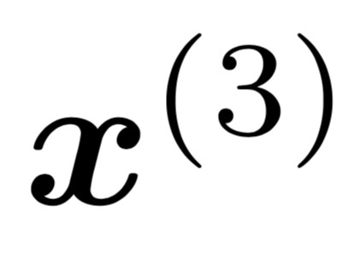
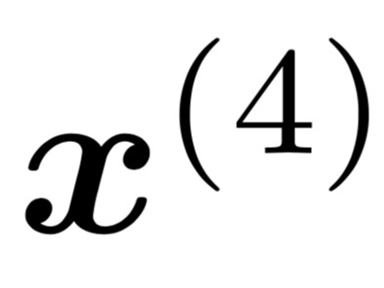
A fixed-window neural Language Model
books
laptops
output distribution
a
zoo
hidden layer
concatenated word embeddings
words / one-hot vectors
the students
opened
their
Christopher Manning & Abigail See

Slide 21

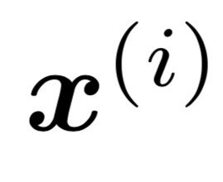
A fixed-window neural Language Model
Improvements over n-gram LM:
No sparsity problem
Model size is O(n) not O(exp(n))
books
laptops
Remaining problems:
Fixed window is too small
Enlarging window enlarges
Window can never be large enough!
Each uses different rows of . We don’t share weights across the window.
a
zoo
We need a neural architecture that can process any length input
the students
opened
their
Christopher Manning & Abigail See

Slide 22
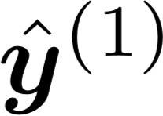
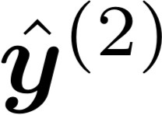
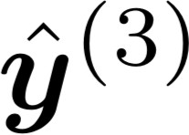
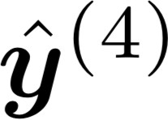
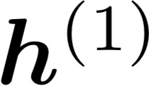
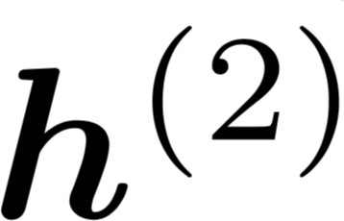
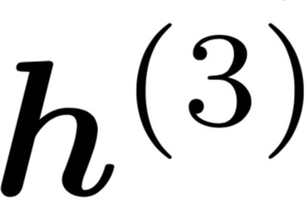
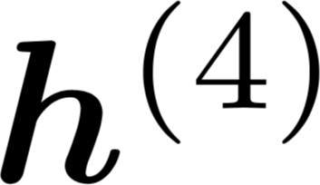


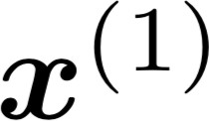
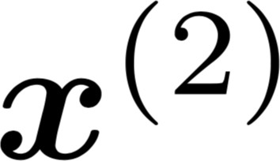
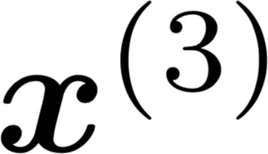
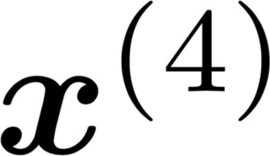
Core idea: Apply the same weights repeatedly
Recurrent Neural Networks (RNN)
A family of neural architectures
outputs (optional)
…
hidden states
…
input sequence (any length)
…
Christopher Manning & Abigail See

Slide 23
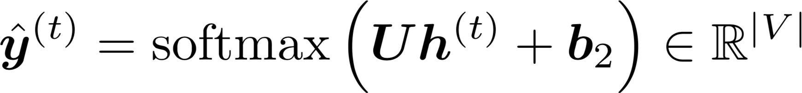


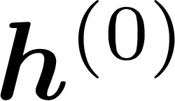


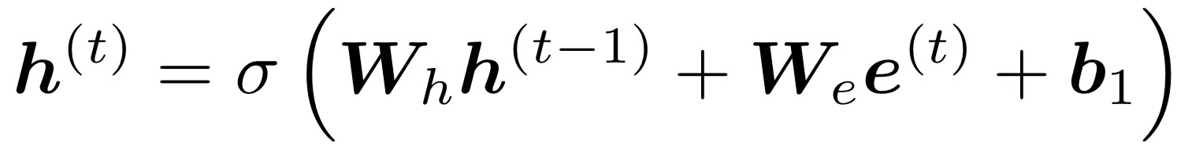
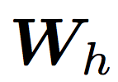





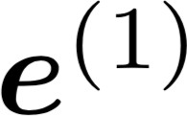
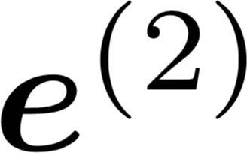
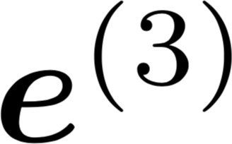
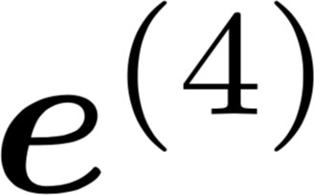
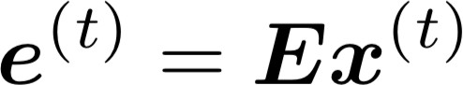


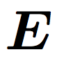
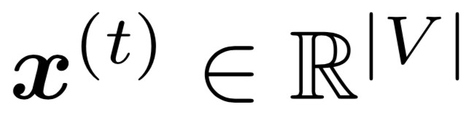
A RNN Language Model
books
laptops
output distribution
a
zoo
hidden states
is the initial hidden state
word embeddings
words / one-hot vectors the students
opened
their
Note: this input sequence could be much longer, but this slide doesn’t have space!
25
2/1/18
Christopher Manning & Abigail See

Slide 24
A RNN Language Model
books
laptops
RNN Advantages:
Can process any length input
Model size doesn’t increase for longer input
Computation for step t can (in theory) use information from many steps back
Weights are shared across timesteps →  representations are shared
a
zoo
RNN Disadvantages:
Recurrent computation is slow
In practice, difficult to access information from
₂₆many steps back
More on these next week
the students
opened
their
2/1/18
Christopher Manning & Abigail See

Slide 25
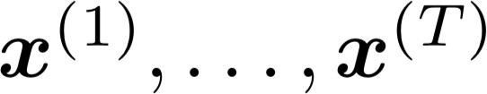
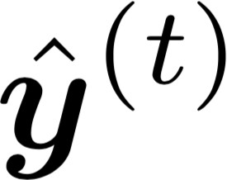
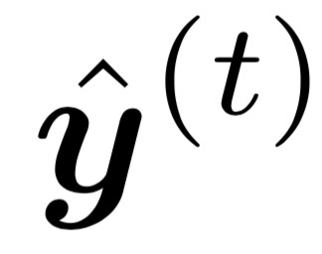
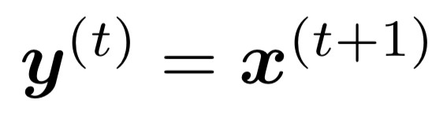
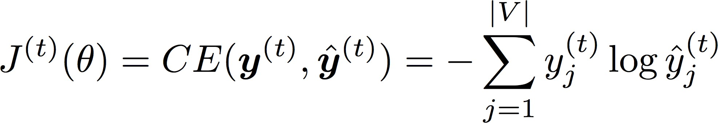
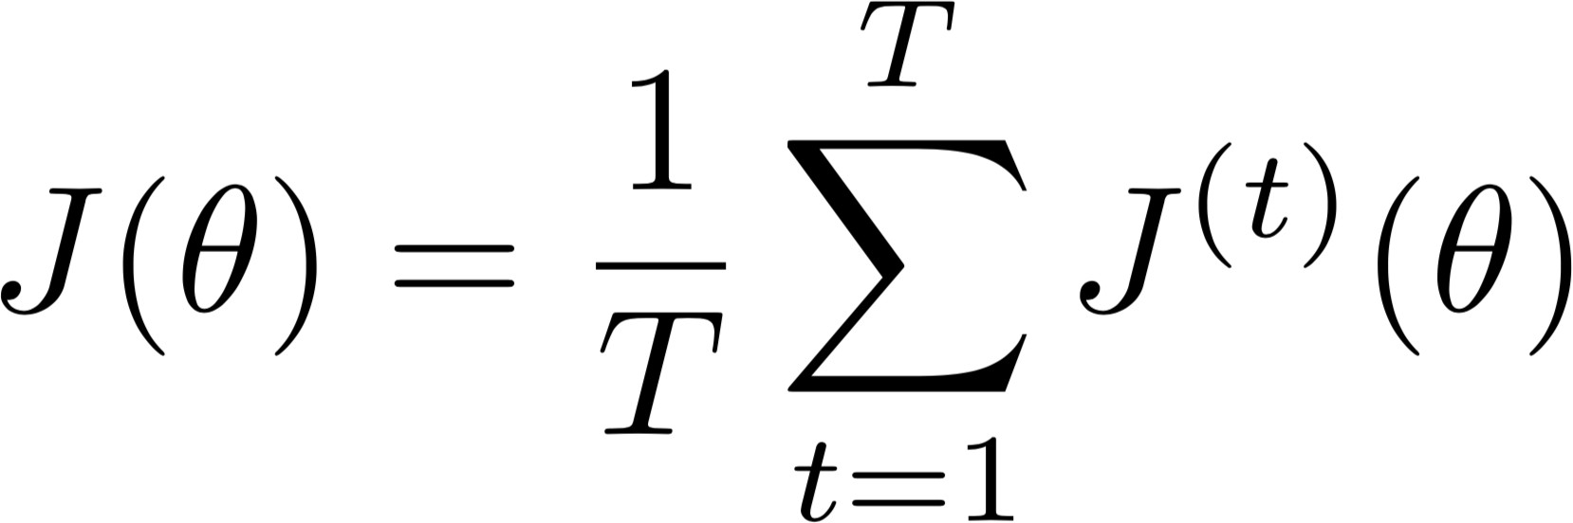
Training a RNN Language Model
Get a big corpus of text which is a sequence of words
Feed into RNN-LM; compute output distribution
for every step t.
i.e. predict probability dist of every word, given words so far
Loss function on step t is usual cross-entropy between our predicted probability distribution , and the true next word :
Average this to get overall loss for entire training set:
Christopher Manning & Abigail See

Slide 26
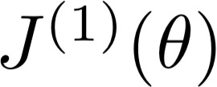
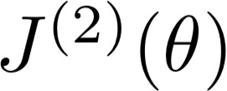





Training a RNN Language Model
= negative log prob of “students”
Loss
…
Corpus
the
students
opened
their
exams
…
Christopher Manning & Abigail See

Slide 27
Training a RNN Language Model
= negative log prob of “opened”
Loss
…
Corpus
27
the
students
opened
their
exams
…
Christopher Manning & Abigail See

Slide 28
Training a RNN Language Model
= negative log prob of “their”
Loss
…
Corpus
the
students
opened
their
exams
…
Christopher Manning & Abigail See

Slide 29
Training a RNN Language Model
= negative log prob of “exams”
Loss
…
Corpus
the
students
opened
their
exams
…
Christopher Manning & Abigail See

Slide 30
Training a RNN Language Model
Loss
+
+
+
+ … =
…
Corpus
the
students
opened
their
exams
…
Christopher Manning & Abigail See

Slide 31

Training a RNN Language Model
However: Computing loss and gradients across entire corpus is too expensive!
Recall: Stochastic Gradient Descent allows us to compute loss and gradients for small chunk of data, and update.
→ In practice, consider as a sentence
Compute loss for a sentence (actually usually a batch of sentences), compute gradients and update weights. Repeat.

Slide 32




Backpropagation for RNNs
…
…
Question: What’s the derivative of weight matrix ?
Answer:
w.r.t. the repeated
“The gradient w.r.t. a repeated weight is the sum of the gradient
w.r.t. each time it appears”
Why?
Christopher Manning & Abigail See

Slide 33


Multivariable Chain Rule
Source:
https://www.khanacademy.org/math/multivariable-calculus/multivariable-derivatives/differentiating-vector-valued-functions/a/multivariable-chain-rule-simple-version
Christopher Manning & Abigail See

Slide 34







Backpropagation for RNNs: Proof sketch
In our example:
Apply the multivariable chain rule:
= 1
…
Source:
https://www.khanacademy.org/math/multivariable-calculus/multivariable-derivatives/differentiating-vector-valued-functions/a/multivariable-chain-rule-simple-version
Christopher Manning & Abigail See

Slide 35




Backpropagation for RNNs
…
…
Answer: Backpropagate over timesteps i=t,…,0, summing gradients as you go.
This algorithm is called
“backpropagation through time”
Question: How do we calculate this?
Christopher Manning & Abigail See

Slide 36
Generating text with a RNN Language Model
Just like a n-gram Language Model, you can use a RNN Language Model to generate text by repeated sampling. Sampled output is next step’s input.
favorite
sample
season
sample
is
sample
spring
sample
…
my
favorite
season
is
spring
Christopher Manning & Abigail See

Slide 37


Generating text with a RNN Language Model
Let’s have some fun!
You can train a RNN-LM on any kind of text, then generate text in that style.
RNN-LM trained on Obama speeches:
Source: https://medium.com/@samim/obama-rnn-machine-generated-political-speeches-c8abd18a2ea0
Christopher Manning & Abigail See

Slide 38


Generating text with a RNN Language Model
Let’s have some fun!
You can train a RNN-LM on any kind of text, then generate text in that style.
RNN-LM trained on Harry Potter:
Source: https://medium.com/deep-writing/harry-potter-written-by-artificial-intelligence-8a9431803da6
Christopher Manning & Abigail See

Slide 39


Generating text with a RNN Language Model
Let’s have some fun!
You can train a RNN-LM on any kind of text, then generate text in that style.
RNN-LM trained on Seinfeld scripts:
Source: https://www.avclub.com/a-bunch-of-comedy-writers-teamed-up-with-a-computer-to-1818633242
Christopher Manning & Abigail See

Slide 40


Generating text with a RNN Language Model
Let’s have some fun!
You can train a RNN-LM on any kind of text, then generate text in that style.
(character-level) RNN-LM trained on paint colors:
Source: http://aiweirdness.com/post/160776374467/new-paint-colors-invented-by-neural-network
Christopher Manning & Abigail See

Slide 41

Evaluating Language Models
The traditional evaluation metric for Language Models is perplexity.
Normalized by number of words
Inverse probability of dataset
Lower is better!
In Assignment 2 you will show that minimizing perplexity and minimizing the loss function are equivalent.
Christopher Manning & Abigail See

Slide 42

RNNs have greatly improved perplexity
n-gram model
Increasingly complex RNNs
Perplexity improves (lower is better)
Source: https://research.fb.com/building-an-efficient-neural-language-model-over-a-billion-words/
Christopher Manning & Abigail See

Slide 43
Why should we care about Language Modeling?
Language Modeling is a subcomponent of other NLP systems:
Speech recognition
These systems are called conditional Language Models
Use a LM to generate transcription, conditioned on audio
Machine Translation
Use a LM to generate translation, conditioned on original text
Summarization
Use a LM to generate summary, conditioned on original text
Language Modeling is a benchmark task that helps us measure our progress on understanding language
Christopher Manning & Abigail See

Slide 44
Recap
Language Model: A system that predicts the next word
Recurrent Neural Network: A family of neural networks that:
Take sequential input of any length
Apply the same weights on each step
Can optionally produce output on each step
Recurrent Neural Network ≠ Language Model
We’ve shown that RNNs are a great way to build a LM.
But RNNs are useful for much more!
Christopher Manning & Abigail See

Slide 45

RNNs can be used for tagging
e.g. part-of-speech tagging, named entity recognition
DT
VBN
NN
VBN
IN
DT
NN
the
startled
cat
knocked
over
the
vase
Christopher Manning & Abigail See

Slide 46



RNNs can be used for sentence classification
positive
How to compute sentence encoding?
e.g. sentiment classification
Sentence encoding
overall
I
enjoyed
the
movie
a
lot
Christopher Manning & Abigail See

Slide 47

RNNs can be used for sentence classification
positive
How to compute sentence encoding?
e.g. sentiment classification
Basic way:
Use final hidden state
Sentence encoding
overall
I
enjoyed
the
movie
a
lot
Christopher Manning & Abigail See

Slide 48
RNNs can be used for sentence classification
positive
How to compute sentence encoding?
e.g. sentiment classification
Usually better:
Take element-wise max or mean of all hidden states
Sentence encoding
overall
I
enjoyed
the
movie
a
lot
Christopher Manning & Abigail See

Slide 49

RNNs can be used to generate text
e.g. speech recognition, machine translation, summarization
what’s
the weather
<START>
what’s
the
Remember: these are called “conditional language models”. We’ll see Machine Translation in much more detail later.
Christopher Manning & Abigail See

Slide 50



RNNs can be used as an encoder module
Answer: German
e.g. question answering, machine translation
Question encoding
= element-wise max of hidden states
Context: Ludwig van Beethoven was a German composer and pianist. A crucial figure …
Here the RNN acts as an encoder for the Question. The encoder is part of a larger neural system.
Question: what
nationality was
Beethoven
?
Christopher Manning & Abigail See

Slide 51








A note on terminology
RNN described in this lecture = “vanilla RNN”
Next lecture: You will learn about other RNN flavors
like GRU and LSTM
and multi-layer RNNs
By the end of the course: You will understand phrases like
“stacked bidirectional LSTM with residual connections and self-attention”
Christopher Manning & Abigail See

Slide 52
Next time
Problems with RNNs!
Vanishing gradients
motivates
Fancy RNN variants!
LSTM
GRU
multi-layer
bidirectional
Christopher Manning & Abigail See

